Slide 1
Azure deployment Envs
Cloud Team
2021.06.02

Slide 2
All Azure Deployment Envs
There are 9 Azure deployment envs currently being used actively in total.
wow00 [Big volume Test]
wow01 [WoW SIT]
wow02 [WoW UAT]
wowprod00 [WoW Production]
sti [STI QA Test]
common00 [Common Deployment]
SEG [EU Demo Deployment]
SEG [EU Common Deployment]
Asia Prod 01 [GS25]
East US Prod 01 [SAI US]

Slide 3
1. wow00 [Big volume Test]
https://stage00.wow.solumesl.com/
Location:
Australia East
Subscription:
solumesl01
Application Gateways:
wowstageaag00
AKS Cluster:
wow-stage-aks00
Event Hubs:
wow-stage-eventhub00
Iot Hub:
wow-stage-iothub00
Storage:
wowstagestorage00

Slide 4
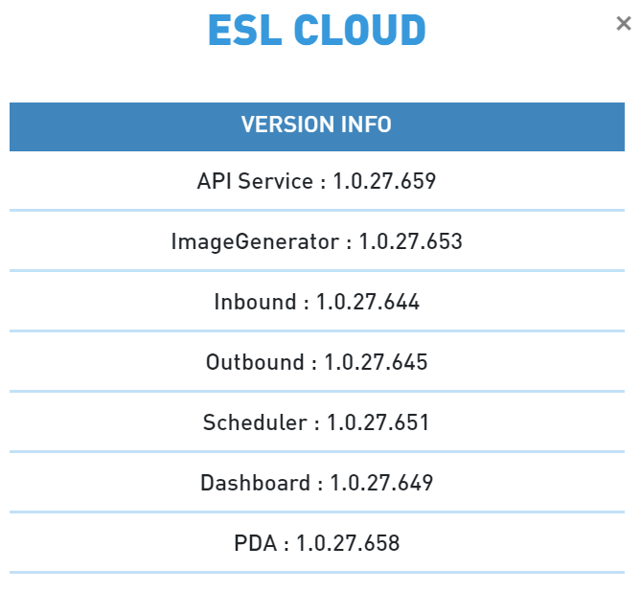
2. wow01 [WoW SIT]
https://stage01.wow.solumesl.com/
Location:
Australia East
Subscription:
solumesl01
Application Gateways:
wowstageaag01
AKS Cluster:
wow-stage-aks01
Event Hubs:
wow-stage-eventhub01
Iot Hub:
wow-stage-iothub01
Storage:
wowstagestorage01

Slide 5
3. wow02 [WoW UAT]
https://stage02.wow.solumesl.com/
Location:
Australia East
Subscription:
solumesl01
Application Gateways:
wowstageaag02
AKS Cluster:
wow-stage-aks02
Event Hubs:
wow-stage-eventhub02
Iot Hub:
wow-stage-iothub02
Storage:
wowstagestorage02

Slide 6
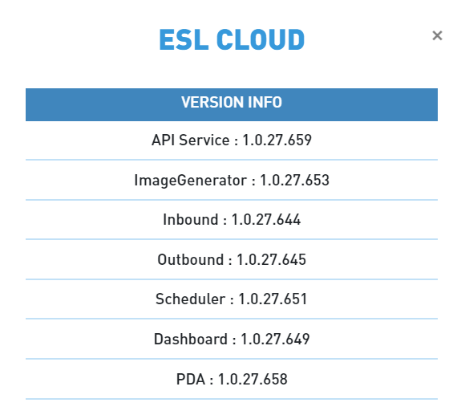
4. wowprod00 [WoW Production]
https://prod00.wow.solumesl.com/
Location:
Australia East
Subscription:
solumesl01
Application Gateways:
wowprodaag00
AKS Cluster:
wow-prod-aks00
Event Hubs:
wow-prod-eventhub00
Iot Hub:
wow-prod-iothub00
Storage:
wowprodstorage00

Slide 7
5. sti [STI QA Test]
https://sqa.sti.solumesl.com/
Location:
Korea Central
Subscription:
solumesl01
Application Gateways:
appGwStiSqa
AKS Cluster:
sti-stage-qa-akscluster
Event Hubs:
sti-stage-qa-eventhub
Iot Hub:
sti-stage-qa-iothub
Storage:
stistageqastorage

Slide 8
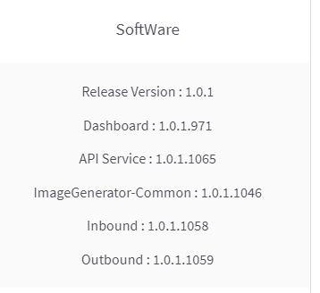
6. common00 [Common Deployment]
https://stage00.common.solumesl.com/
Location:
Korea Central
Subscription:
solumesl01
Application Gateways:
commonstageaag00
AKS Cluster:
common-stage-aks00
Event Hubs:
common-stage-eventhub00
Iot Hub:
common-stage-iothub00
Storage:
commonstagestorage00

Slide 9
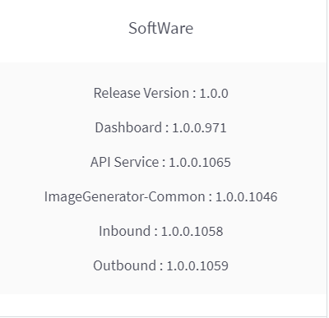
7. seg [EU Demo Deployment]
http://eu.common.solumesl.com/
Location:
Germany West Central
Subscription:
solumesl03
Application Gateways:
segdemoaag
AKS Cluster:
seg-demo-aks
Event Hubs:
seg-demo-eventhub
Iot Hub:
seg-demo-iothub
Storage:
segdemostorage

Slide 10
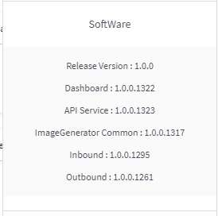
8. seg [EU Common Deployment] (currently used for big volume by SEG)
https://eu01.common.solumesl.com/
Location:
France Central
Subscription:
solumesl03
Application Gateways:
segcommonaag01
AKS Cluster:
seg-common-aks01
Event Hubs:
seg-common-eventhub01
Iot Hub:
seg-common-iothub01
Storage:
segcommonstorage01

Slide 11
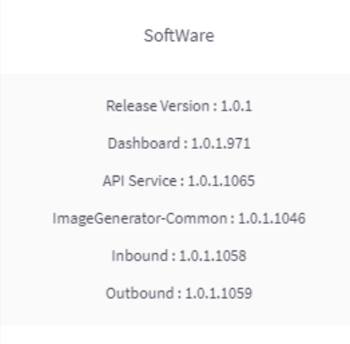
9. Asia Prod 01 [GS25]
http://kr.common.solumesl.com/
Location:
Korea Central
Subscription:
solumesl04
Application Gateways:
asiaprodaag01
AKS Cluster:
asia-prod-aks01
Event Hubs:
asia-prod-eventhub1
Iot Hub:
asia-prod-iothub1
Storage:
asiaprodstorage1

Slide 12
10. East US Prod 01 [SAI US]
http://eastus.common.solumesl.com/
Location:
East US
Subscription:
solumesl05
Application Gateways:
eastusprodaag01
AKS Cluster:
eastus-prod-aks01
Event Hubs:
eastus-prod-eventhub01
Iot Hub:
eastus-prod-iothub01
Storage:
eastusprodstorage01

Slide 13

THANK YOU

